Slide 1
Impact of Quarterly Earnings on Stock Returns
FRE-6883 Financial Computing in C++
Contributors:
Cristobal Gonzalez
Deniz Kural
Albert Lee
Lincoln Lin
Liam Trodden

Slide 2
Abstract
The purpose of this project is to understand the impact of a company’s earning release on its stock returns. Intuition tells us that companies that exceed expectations should see positive impact on their share prices. To test this hypothesis, we first categorize stocks into three groups of relatively even size based on whether they beat, meet, or miss their earnings expectation. Second, we randomly sample stocks from each group and compute the average of the relative returns against an index (to drop market noise) for the dates surrounding the announcement day. Finally, we visualize the cumulative average of these returns for each group.
Notes:
Walk through the intention of the program and how we understood and implemented our version of the code

Slide 3
Team Member Responsibilities
Cristobal | Project design Bootstrapping
Deniz | Data Retrieval Stage - Algorithm Implementation Libcurl implementation
Albert | Visualization: Excel Driver and gnuplot Validate performance of functions
Lincoln | Zacks data extraction & Data Initiations, Return Creations & Random Sampling
Liam | Data integration and testing Libcurl implementation
Notes:
Own Grades:
Cristobal: 10/10
Deniz: 10/10
Albert: 10/10
Lincoln: 10/10
Liam: 10/10

Slide 4
Stock Selection Process
Used MATLAB script to run a Zack’s query, downloading csv containing
Ticker
Announce date
Earnings expected
Earnings actual
Earning surprise %
Zack’s CSV file contains 487 stock info.
505 stocks in S&P 500, minus 16 stocks that have “0” expectations, and 2 stock that have weekend announcements.
Notes:
Explain the matlab script and why some of the stocks on S&P 500 is removed.

Slide 5
Project Data Structure Overview
Data Class
Store map with tickers and corresponding stock object
Populate all stock objects
Populate the three group object
FinInst Class
Store price and date vectors
Method to set class data from server
Class Group
Store map of stock objects
Calculates and stores AAR, CAAR
Sends these vectors to visualizer
Child classes of FinInst:
Stock & ETF
Notes:
In a very high level, the project is structured with a class Data that stores all the information needed.
The most important data member of this class is a Map container that has Stock objects inside of it with their tickers as key values.
These stocks objects get populate with Zacks and Yahoo data inside some of the Data class member functions.
Also this Data Class classifies stock tickers in the three Group categories.
Independently, we created Group Objects, one for each group (beat, meet, miss), using the Data Class Object and the previous classification.
In these final objects we calculate the AAR and CAAR and the other required metrics.

Slide 6
Project Data Structure
FinInst Class
Data Members:
Ticker
Name
PriceDates
PriceValues
Returns
StartDate
EndDate
Cookies
Crumb
N
Member Functions:
InitLibCurl
CallYahoo
SetTicker
SetName
CreateReturns
… (plus constructors and GetDataMember functions)
ETFs Class: FinInst
Member Functions:
FindReturns
SetBenchDates
… (plus constructors)
Stock Class: FinInst
Data Members:
Announcement Date
PeriodDate
SurprisePerc
Benchmark (ETFs Pointer)
AbReturns
Member Functions:
CallYahoo
SetBenchmark
CreateAbReturns
SetN
… (plus constructors and GetDataMember functions)
Notes:
As a group we wanted to create a project structure that can be as independent as possible to the requirements of the project.
Since we are working with Stocks and ETF (in this case as a benchmark), we decided to build a parent class called FinInst (Financial Instrument) without thinking about the AAR, CAAR, bootstrapping, and all the specific requirements of this project. So this part of the code can be reused anytime we would work with these types of financial assets.
This FinInst class has to child classes: Stocks and ETF, but it could have as many asset types as required the situation.

Slide 7
Project Data Structure
Data Class
Data Members:
StockTickers
BenchTicker
StockMap
BenchMap
beat
meet
miss
Member Functions:
SetStockN
SetYahoo
Group
maxdate
Mindate
printstockinfo
… (plus constructors and GetDataMember functions)
Group Class
Data Members:
DataPtr (Data class pointer)
GrpStockMap
group_tickers
AAR
CAAR
AverageAAR
AverageCAAR
StdDevAAR
StdDevCAAR
Member Functions:
Bootstraping
Refresh
IsInGroup
GetStockInfo
RandomSampling
… (plus constructors and GetDataMember functions)
Notes:
This part is much more specific to what was asked to do in this project.
The most important task to us was to build the entire project focusing on the running time and computational effort.
Therefore every object created in the Data Class Map is going to be reused through the entire project without recreating or copying objects.
As we said before, StockMap and BenchMap will be populated with the data available inside the constructor and inside the member functions SetYahoo.
Inside beat, meet, and miss data members (from Data class) will have the tickers that belong to each group.

Slide 8
Project Initialization
...
Data Object
Option 1
Insert N
Populate StockMap
With Zacks information
Data.Group()
Data.SetStockN()
Check ETF Dates
Set N for each Stock
Populate Data Members:
Beat, Meet, Miss with Tickers
Data.SetYahoo()
Beat Object
Group Beat( Data*, Data.GetBeat() )
Each Stock: CallYahoo
Meet Object
Find Announcement Day in ETFs data, get +- N Days
Miss Object
CallYahoo()
Populate GrpStockMap
Without creating new objects
CreateAbReturns()
ETFs Object
Find Returns
Beat.Refresh()
Dates
...
InitLibcurl
Meet.Refresh()
Clear AAR and CAAR
Get AAR and CAAR each Stock
Bootstrapping
CallYahoo
CreateReturns
Miss.Refresh()
Notes:
This is the process about how the project is initialized before getting inside the menu.
The only user input required is the “insert N” part. Where we forced the execution of the option 1, so if the first option of the user is to plot the results, the data would be loaded and calculations ready.

Slide 9
Menu
Menu Options:
1: Enter N to retrieve historical price data for all stocks
2: Pull information for one stock from one group
3: Show AAR, AAR-SD, CAAR and CAAR-STD for one group
4: Show the Excel or gnuplot graph with CAAR for all 3 Group
5: Enter Ticker, Start and End dates for ETF
6: Exit program
Notes:
Deniz
Our menu has 6 options as you can see from the listed options here. Five of the options listed options in the menu are the requirements. Moreover, as an enhancement to project, we add another option called “Enter Ticker, Start and End dates for ETF” which is for user to change the benchmark ETF whenever he/she wants. These menu options will appear when the program execution finishes. Basically, user could just select option 3 and 4 in order to show results for the given N at the initialization of the program. Also, he could print the desired stock information with option 2. Option 1 could be used for entering different N and then, rerun the program for that specific N with respective outputs and plots.

Slide 10
Further Elaboration on:
Using libcurl to Retrieve Price Data
FinInst has callYahoo member function to populate the price vector for that Financial Instrument object
ETF calls the base class function callYahoo(string StartDate, string EndDate)
Stock calls overloaded function callYahoo(vector <string> etfdates)
Stock :: callYahoo() will use day0 and N to find StartDate and EndDate, then call the base class method
ETFs Object
Dates
InitLibcurl
CallYahoo
CreateReturns
Notes:
Deniz
Let’s first start talking with data retrieval stage. In data retrieval stage,we are using LibCurl library in order to get stock information from Yahoo Finance. This library is ready to use and basically, - and furtherly explained- they get the necessary information that are date and price for each stock in our case from the website Yahoo Finance. To implement this library to our algorithm, we used two functions that are called setyahoo and overloaded function callyahoo(). Let me first go through these functions and then algorithm of our data retrieval stage. Setyahoo is the first called function and that is for iterating through stock map. CallYahoo is for populating the price and date info. Of fin.inst. Object. ETF will use the base class to obtain its info. As you can see from figure, this class will have dates, init.Libcurl, callyahoo and createreturn calls. On the other hand, stock calls the overloaded func. First at the stock class.

Slide 11
Further Elaboration on:
Using libcurl to Retrieve Price Data
First, we initialize an ETF object in main, and call InitLibCurl().
This performs the set up for libcurl, including getting the cookie and crumb as a string.
In Data class we call setYahoo(), which iterates over every object in the stock map and calls its respective callYahoo function.
In this same iteration loop we also set the abnormal returns vectors.
Data.SetYahoo()
Each Stock: CallYahoo
Find Announcement Day in ETFs data, get +- N Days
CallYahoo()
CreateAbReturns()
Find Returns
Notes:
Deniz
Let’s talk about algorithm. When we run the code, first thing happening is that we initialize our ETF object with start, end date and also ticker which SPY in our case. After that, we initialize LibCurl. How are we doing that? We are creating cookie and crumb string there and hold those in order to speed up the execution of code. Also, Global Curl function needs to be called one in the initialization of the LibCurl. Now, let’s talk about stocks and how they get data from Yahoo. We first call Stock::SetYahoo() function and this function iterates through stock map. In each iteration, first price and date information is found and then return info. Is found.SetYahoo calls CallYAhoo for LibCurl. In the Stock::CallYahoo we find the start and end date by matching announcement date and etf dates and also given N input. I think that this function gives a uniqueness for our approach to problem. After we set start and end date, we call Fininst::CallYahoo() for Libcurl and to find price and date info of stocks. These values are obtained at the loop in the fininst::CallYahoo by extracting each date’s line info. From Yahoo Finance. With the found info, we set abnormal returns for that specific stock. ( MENTION THE FIGURE IN THE PRESENTATION)

Slide 12
Further Elaboration on:
Manage Data and Calculations
Initialize Data class object, passing through list of string Tickers from csv file
Call Data::Group(), dividing stocks into 3 groups, setting respective vectors of string tickers beat, meet, and miss
Ticker vector is ordered by surprise percentage, Group() sets beat, meet, and miss equal to the top, middle, and bottom third, respectively
Data Object
Populate StockMap
With Zacks information
Data.Group()
Populate Data Members:
Beat, Meet, Miss with Tickers

Slide 13
Further Elaboration on:
Manage Data and Calculations
Beat Object
Group Beat( Data*, Data.GetBeat() )
Initialize three group objects: Beat, Meet, Miss
Each group object contains a map pointing to all stock objects in respective category
Call Group::Bootstrapping(), generating bootstrapped samples and calculating vectors for AAR, CAAR, StdDevAAR, and StdDevCAAR
Meet Object
Miss Object
Populate GrpStockMap
Without creating new objects
Beat.Refresh()
Meet.Refresh()
Clear AAR and CAAR
Get AAR and CAAR each Stock
Bootstrapping
Miss.Refresh()

Slide 14
Further Elaboration on:
Visualization (gnuplot)
int plotCAAR(const vector<double>& beat,
const vector<double>& meet,
const vector<double>& miss);
Pre-condition: 3 vectors of type double of a same size are passed as parameters
Post-condition: plot 3 lines of CAAR on one canvas
return 0 if successful
return 1 if unsuccessful
Notes:
This is the function declaration in the header file.
It includes necessary information that other programmers need to understand in order to use plotCAAR function
To illustrate, the function requires 3 vectors of type double of a same size as function parameters.
If the pre-condition is met, the function will plot 3 lines of data on a pop-up window and return 0.
If the 3 vectors are of different sizes, the function will output the message “vector sizes do not match” and return 1.
Also, if the function cannot find the path to gnuplot.exe, it will output the message “gnuplot cannot be opened” and return 1.
For windows, the path needs to be set manually to specify the location of gnuplot.exe in _popen function, but for MAC, the path was identical in popen function
If gnuplot was installed according to the instruction given to us.
If we were to make the function recognize whether the operating system is Windows or MAC OS, we should define if statements that check the operating system.
For example, we could define char array or string variable to request and read the input such as windows or mac and also request the user to input to type the directory of gnuplot.exe and execute if statements to call popen or _popen functions with the input variables passed as parameters based on the operating system.

Slide 15
Further Elaboration on:
Visualization (gnuplot)
Check the passed vectors have the same size
Check if gnuplot.exe is successfully opened
Set the range on x-axis [-N+1, N]
Format the plot for easy-reading
Display the plot on a pop-up window
Notes:
This is what we want plotCAAR function to do.
We want the function to check the vectors are the same size because CAAR of each group should have the same number of data points.
Also, we want the function to check if calling gnuplot.exe is successful and notify the problem to the user if it is not successful.
Since CAARs will have the range -N+1 days from the announcement date to +N from the announcement date, we set the range to be always [-N+1, N]
We tried several formats of the plot referring to gnuplot documentation and set up the format in the function to have the best-looking graph.
We made sure it pops up a window to display the graph (wxt).

Slide 16
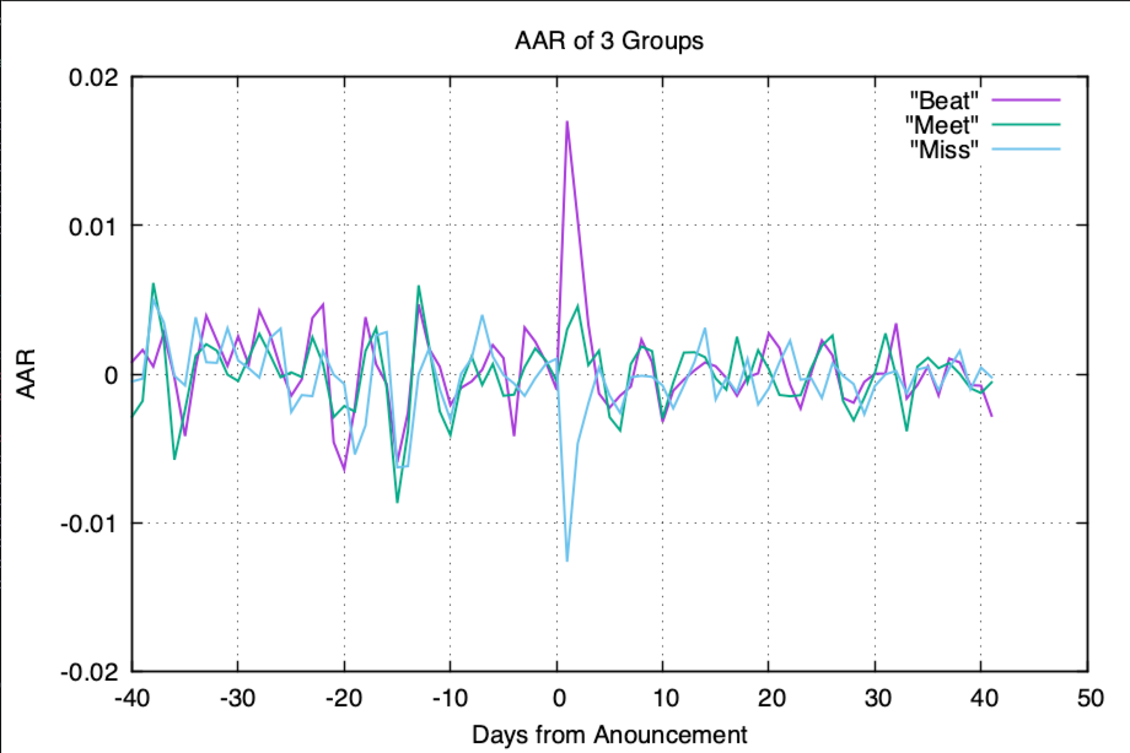
Results: AAR Plot
Notes:
plotCAAR can be used to properly graph AAR, AAR STD, CAAR, CAAR STD, Return, abnormal return, which have the size of 2N.
We set the starting point of x to be -N+1, so it is not properly set the range for prices which have the size of 2N + 1

Slide 17
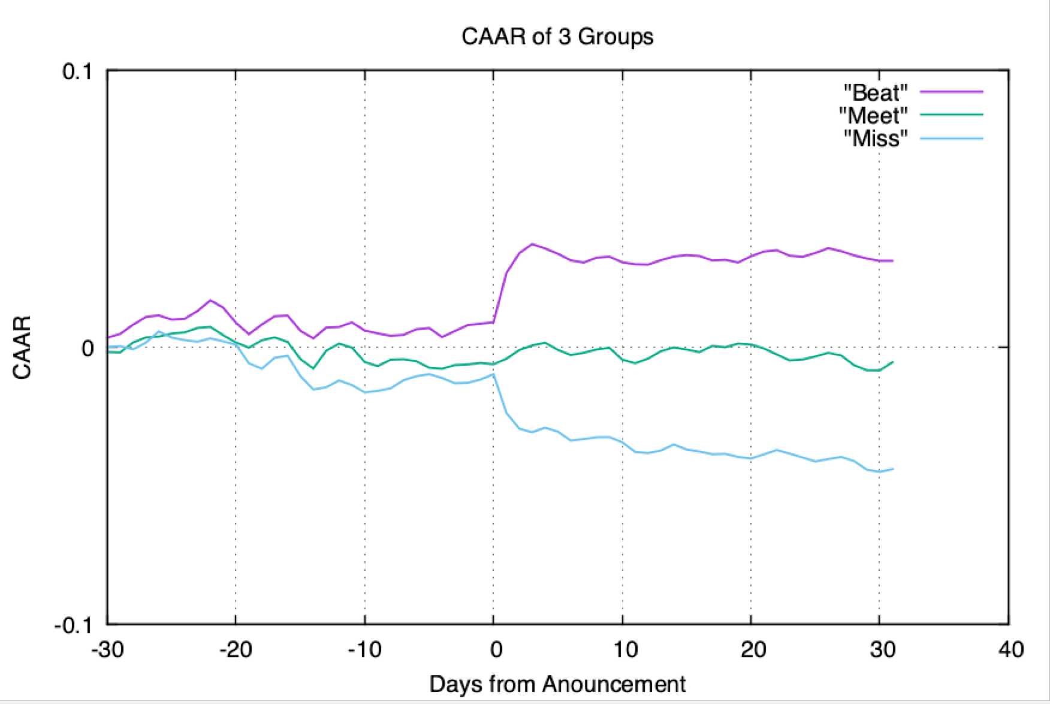
Results: CAAR Plot

Slide 18
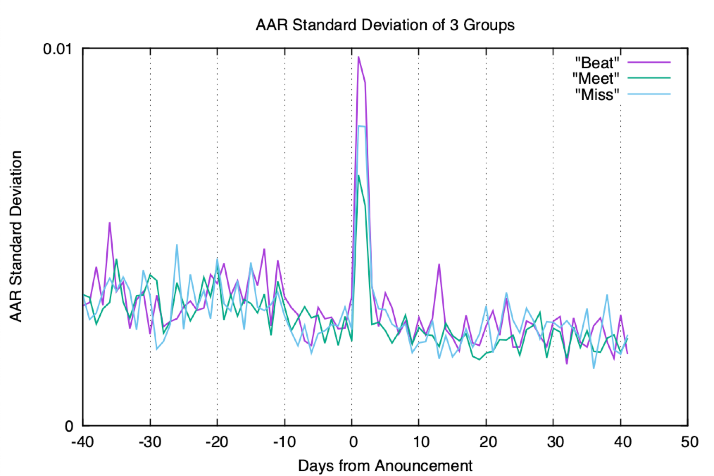
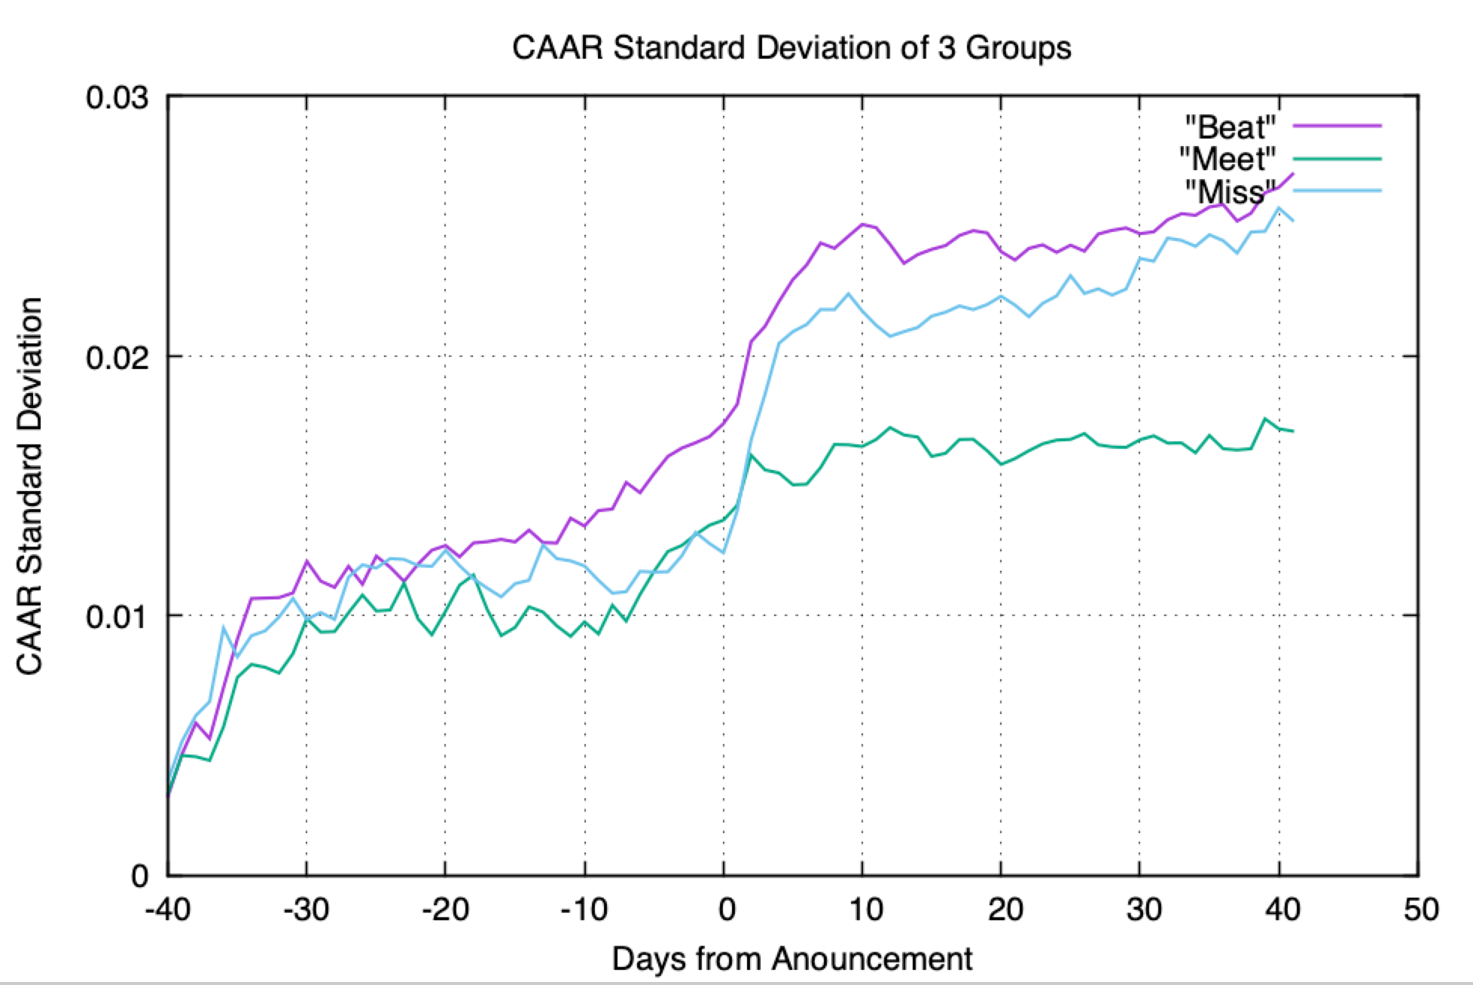
Results: Standard Deviation AAR and CAAR

Slide 19
Results
AAR plot clearly indicates positive spike in returns immediately following announcement date for the beat group
Similarly, negative spike in AAR for the miss group
No discernible impact on AAR for the meet group
CAAR plot seems to indicate there no reversion effect - impact of earnings announcement (any gains / losses made in the AAR spike) were generally maintained after the spike
Notes:
Liam
From the AAR plot, we can see data mostly centered around zero with some noise. But, there is a clear spike in activity immediately after the announcement date. This coincides with standard deviation spike at the same time. The direction seems to correspond to the intuition: that positive surprise causes high stock returns and vice versa for negative surprise. Expectation meeting stocks do not show enough difference to conclude it is not noise. Interestingly, these gains made so not seem to be temporary. Some may have predicted that gains made during the spike would be countered in the days following with returns in the opposite direction, but the CAAR plot seems to indicate that this is not the case, at least for the sample size shown.

Slide 20
Conclusion
Planning: designed structure and divided work into three areas
Data retrieval
Bootstrapping and calculations
Visualizations
Retrieved data from Yahoo Finance servers
Passed data to appropriate classes for calculations
Performed bootstrapping and AAR / CAAR per group
Generated visualized plot of results
Results confirmed initial hypothesis that positive earnings surprise leads to positive impact on stock returns, vice versa for negative surprises
Notes:
Liam
To conclude, the first step in the development process was planning and design. At this point, we divided the necessary labor into three main sections: data retrieval, bootstrapping and calculations, and visualization. The division was not absolute, and there was much cross functional collaboration. We were able to utilize the libcurl library to pull stock data from Yahoo Finance into memory. We were able to form appropriate data structures to properly store that data for use in bootstrapping and calculations. Finally, we were able to visualize the graphs of AAR, CAAR, StdDevAAR, and StdDevCAAR for each group. Having done all this, we are able to confirm our initial hypothesis with a high degree of certainty.

Slide 21
Enhancements
Added menu option to allow user to change the benchmark security.
Implemented compatibility for individual stocks to be benchmarked against different ETFs
Unique function for setting date boundaries for stock data extraction
Added method to catch libcurl failure while running the program.
Efficiency in object initialization
Notes:
Liam
As far as enhancements to the project description go, we implemented a couple of features that enhance the forward compatibility of the program. We wanted to add some flexibility when it comes to the benchmark used for abnormal returns, so we added a menu option for the user to change the benchmark security from the default. Additionally, because of the structure of the program, there is the potential to add more than one ETF, and benchmark stocks against any available chosen ETF. Our program also includes some efficiency considerations. One of these is a method titled PlusNTradingDays, a unique method of finding the correct start and end dates using the ETF date vector to find dates that are N trading days from the announce day. We also include a method to catch libcurl failure, since the server is not 100% reliable. Finally, our program overall was efficient in object initialization, in that we used pointers rather than initializing objects multiple times.

Slide 22
Reference
“Working with Historical and Market Data.” Song Tang, NYU FRE 6883 Financial Computing Class slides.
“Numerical Method In Finance with C++” Capinski and Zastawniak, Cambridge University Press, 2012.

